Slide 1


DON BOSCO INSTITUTE OF TECHNOLOGY Kumbalagodu, Mysore road, Bengaluru-560074
Department of Information Science and Engineering
FILE STRUCTURE
MINI PROJECT REPORT
ON
“DRESS RENTAL STORE MANAGEMENT SYSTEM”
SUBMITTED BY:
CHANDANA H S[1DB20IS033]
DEEPIKA M L[1DB20IS043]
Under the guidance of:
Ms Varsha R,
Assistant Professor,
Dept. of ISE

Slide 2
AGENDA
ABSTRACT
INTRODUCTION
SCOPE OF PROJECT
SNAPSHOT
CONCLUSION
REFERENCES

Slide 3
ABSTRACT
The abstract of a dress rental store management system project would provide an overview of the system's objectives, features, and benefits. The Dress Rental Store Management System is a comprehensive software solution designed to streamline and automate the operations of a dress rental store. The system aims to improve the overall efficiency, accuracy, and customer experience of managing dress rentals, reservations, inventory, and sales.
Key features of the Dress Rental Store Management System include a user-friendly interface for customers to browse and reserve dresses online, an inventory management module to track dress availability, a reservation management system for scheduling and managing rentals, and a sales and billing module for processing payments and generating invoices. By implementing the Dress Rental Store Management System, dress rental store owners can benefit from several advantages. Firstly, the system simplifies the rental process for customers, allowing them to browse available dresses, check availability, and make reservations conveniently through an online platform. This enhances customer satisfaction and encourages repeat business.

Slide 4
INTRODUCTION
The Dress Rental Store Management System is a comprehensive software solution designed to streamline and automate the operations of a dress rental store. The system aims to simplify the process of managing dress inventory, customer bookings, payments, and overall store management. By implementing this system, dress rental stores can enhance their efficiency, improve customer satisfaction, and ultimately optimize their business operations. Hash tables and indexing are two important concepts that can be used to improve the performance of a Dress Rental Store Management System. A hash table is a data structure that allows for constant time access to data by using a hash function to map keys to indexes in an array. This makes it easy to store and retrieve data based on unique keys, such as phone numbers or email.

Slide 5
SCOPE OF PROJECT
Designing and developing a user-friendly interface for customers to browse, search, and select dresses based on their preferences, sizes, and occasions. This may include features like high-quality product images, detailed descriptions, filtering options, and an intuitive checkout process.Creating a robust system to manage the dress inventory, including adding new dresses, tracking availability, managing sizes and variations, and handling returns and exchanges.Implementing a booking system that allows customers to reserve dresses for specific dates and durations. This may involve managing conflicting reservations, sending confirmation emails, and providing reminders for pickup and return dates.

Slide 6
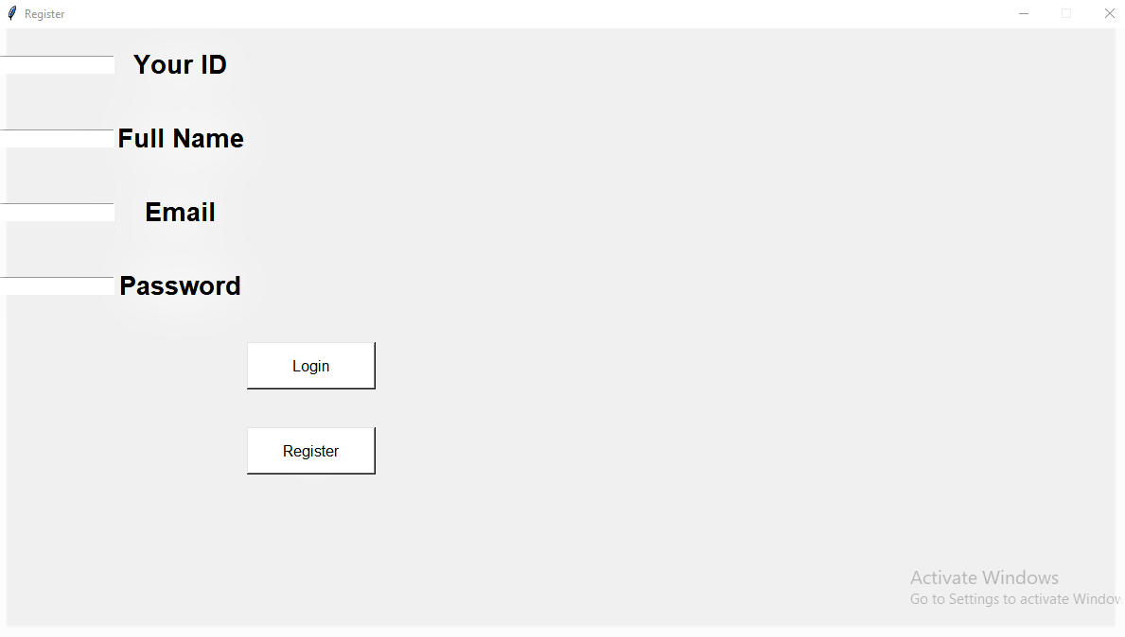
SNAPSHOTS
USER REGISTER PAGE
The Figure opens the page for user to register with own user ID, name,email,password..

Slide 7
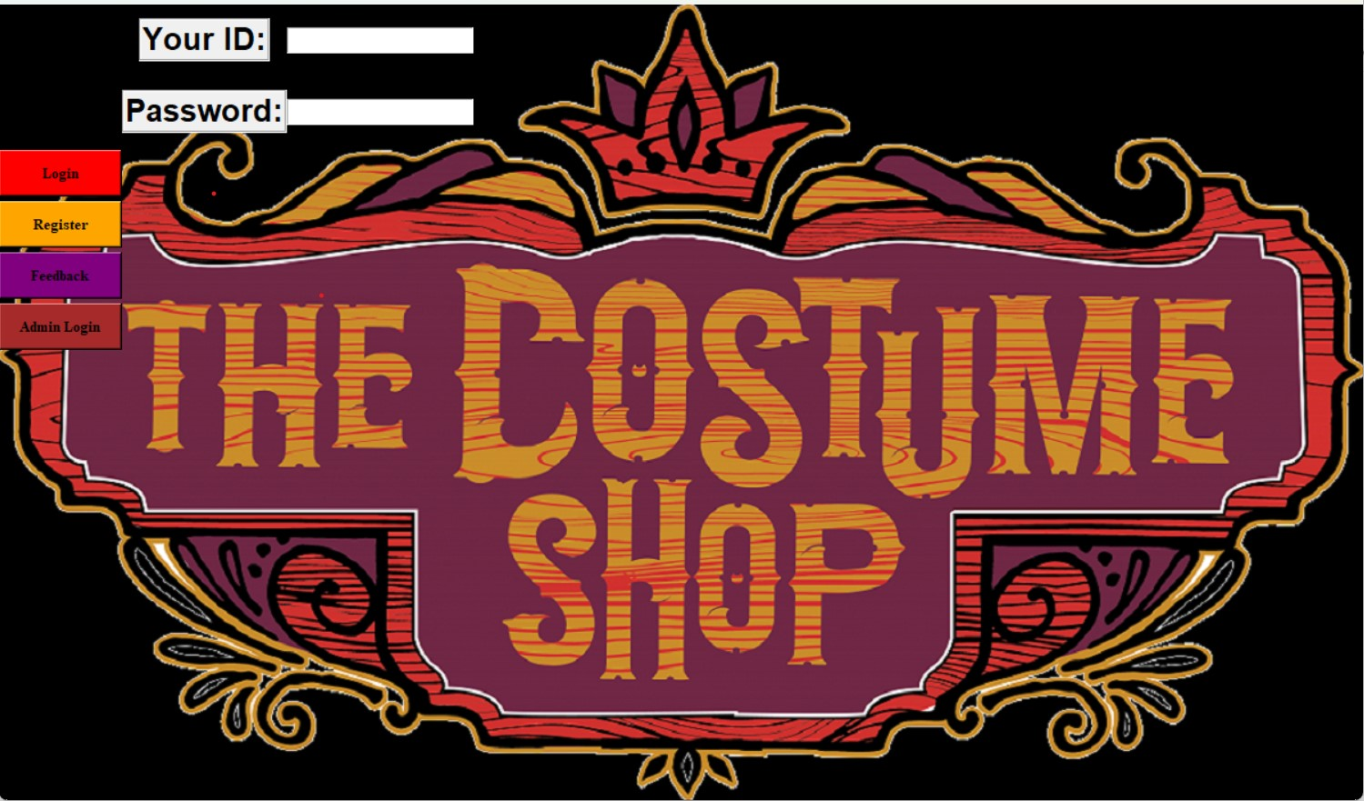
LOGIN PAGE
The Figure shows the login page for the user to login with ID and password. This page shows the admin login option also so that only the admin can access some information.

Slide 8
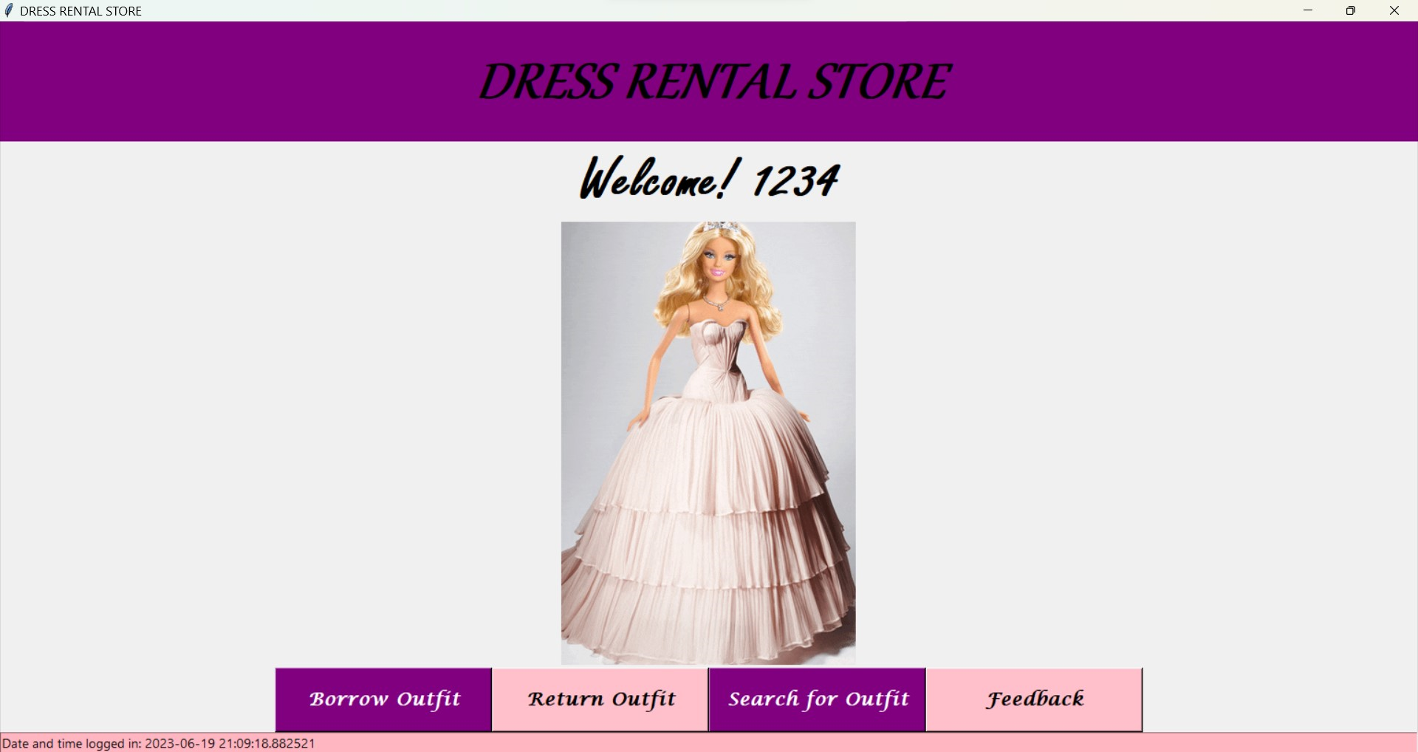
WELCOME PAGE
The Figure 5.3 shows the page where user can borrow, return or search the outfit in this page. The welcome page displays the user ID. The user as to select any of the option to access next page.

Slide 9
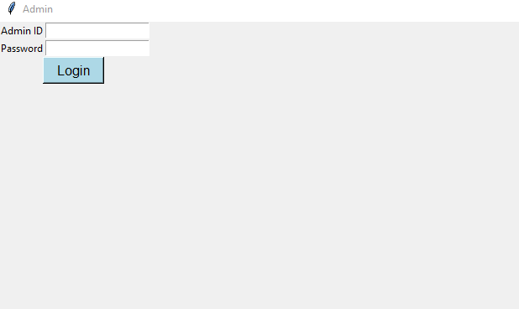
ADMIN LOGIN
The Figure 5.7 shows the admin login page for only admins to access the details. Only the admin can login here so that they can access the details about the dress and modify if any changes required to be done by the admin.

Slide 10
CONCLUSION
The dress rental system provides a convenient and cost-effective solution for individuals who want to wear stylish and fashionable outfits for special occasions without the need to purchase them outright. Throughout this discussion, we have explored the various aspects of a dress rental system, including its benefits, challenges, and considerations. In conclusion, a dress rental system offers several advantages. First and foremost, it allows customers to access a wide range of clothing options, including designer dresses, at a fraction of the cost of purchasing them. This affordability makes high-end fashion more accessible to a broader audience. Additionally, dress rentals enable individuals to wear different styles for each occasion, avoiding outfit repetition and enhancing their fashion choices.

